Slide 1
Examining the impact of manufactured import demand on national endowment sectors of African countries.
Adu George

Slide 2
Abstract
The estimation established that, increase real Gdp has a positive relationship with the importation in the productive sectors. Importations in the productive sectors affected positively the secondary sectors of national endowment sectors of African economies.
Further, importations in capital intensive sectors affected negatively the tertiary sectors of African countries. The results were however mixed with total factor productivity: the implication has been that the level of total factor productivity as measured is positively and negatively affected.
Estimation of the traditional demand function revealed, relative prices to import demand are inelastic, consumer preference for sophisticated imported goods is elastic as real income increases.
Finally, estimations of the demand function with the inclusion of net barter terms of trade show imports are expensive for net importers.

Slide 3
Introduction
Africa has a long history for been very open and have pursued export substitution policies in international trade. Until recently import substitution policies have been more pronounced in the literature and government policies, even though import substitution policies has been in existence, the challenge been effective implementation.
The strategy at present has been industrial transformation coupled with Non-tariff barriers which will allow the ease of goods “fro and into” Africa. Beginning 2000’s African countries have sought to diversify trade relationship towards the Global South.
In 2017 Export shares to Asia in Africa’s total export increased to 27.9 percent from 26.3 percent in 2016 while the share of its export to European Union decreased from 31.7 percent in 2016 to 29.9 percent in 2017 (African trade report 2018).

Slide 4
Introduction con’t
The Global South trade linkages is fundamentally based on an understanding of shared growth, with the South providing greater opportunity for the transformation of the productive and manufacturing sectors of African countries. Trade liberalization has an objective of boosting domestic trade, and international trade through integration: with emphasis on exporting products of comparative advantage and importing products with a scarce resource. In addition is the long run alignment of domestic nominal prices with international prices in tradable goods. Africa’s trade share with the rest of the world is only 2.7 percent in 2018 a decrease from 2.9 percent in 2015.
This poor performance probably explains Africa’s pursuance of an aggressive diversification process and a more robust trade enhancing reforms and initiatives such as trade-facilitating infrastructure and addressing the trade finance gap and a more open trade policy.

Slide 5
Macroeconomic Outlook of the African markets
Table 1.1: major macroeconomic indicators: selected African countries
Countries | Nigeria | South Africa | Egypt | Algeria | Morroco
 | 1980- 1991- 1990 2018 | 1980- 1991- 1990 2018 | 1980- 1991- 1990 2018 | 1980- 1991- 1990 2018 | 1980- 1991- 1990 2018
GDP growth rate | 11.8 1.9 | -0.3 0.8 | 5.7 5.3 | 0.8 2.1 | 3.4 3.0
GDP per capita (annual %) | 8.9 -0.7 | -2.7 -0.6 | 3.1 3.2 | -1.8 0.1 | 1.5 1.6
Agriculture, forestry and fishing, value added( % of GDP) | 21.6 21.2 | 4.2 2.2 | 18.5 11.2 | - 12.3 | 15.1 12.0
Industry, value added(annual growth) | 18.1 1.9 | -1.4 29.0 | 6.1 6.4 | - 2.1 | 8.0 3.1
Manufacturing, value added % of GDP) | 18 8 | 22 12 | 17 16 | 35 | 19 16
Services value added | 42.0 52.0 | 50.5 61.0 | 49.6 51.4 | - 45.6 | 45.0 50.5
Gross capital formation (% of GDP) | 53 15 | 19 18 | 29 17 | 48 | 31 33
Inflation rate(GDP deflator) | 6.7 10.2 | 15.5 3.9 | 17.7 21. 4 | 30.3 10.8 | 7.7 1.6
Net FDI (inflows % of GDP) | 1.1 0.5 | -0.1 1.5 | 1.7 2.7 | 0.0 0.8 | 0.5 3.1
Source: World Development indicators (2018), World Bank data base.

Slide 6
Macroeconomic Indicators con’t
Table 1.2: Comparing projected macroeconomic indicators (2010-2025)
 | Gdp(Billion) constant(2005) 2010 2025 | Gdp per capita constant(2005) 2010 2025 | Share of working age population Tertiary education 2010 2025 | Share of working age population secondary education 2010 2025 | Total factor productivity 2010 2025
Brazil | 1090 1780 | 10034 14768 | 8 12 | 55 65 | 499 639
India | 1211 3092 | 2973 6372 | 6 9 | 47 59 | 182 305
China | 3686 10424 | 6531 17756 | 7 11 | 71 82 | 271 534
Sub-saharan Africa | 790 1680 | 2163 3361 | 3 4 | 29 36 | 198 263
Source: The great shift: macroeconomic indicators for the world economy, at the 2050 horizon

Slide 7
Literature review
Baier and Bergstrand (2001) in explaining factors that account for trade growth showed that, income growth, tariff reductions, lower cost of transportation contributed significantly to the growth of trade. Their estimations revealed that, income growth explains 67 percent of trade, tariff reductions, explains percent, transport cost explained 8 percent growth in trade.
Lai and Zhu (2004) in their analysis of the determinants of bilateral trade found that the elimination of tariffs would create more trade for poor countries(7.9%) than for richer countries (2.5%), diverting trade from continental preferred trading countries ( e.g., European and NAFTA) towards intercontinental trading partners. Thus, tariff liberalization shifts trade from rich to poor and from local to global.

Slide 8
Literature review con’t
Green and Srivastava (1986) included product categories in their model to determine whether the identified factors are better at explaining trade flows. Data were collected from 45 exporting and 82 importing countries. They found a striking difference between manufactured goods (SITC 5, 6, 7 and 8) and the non-manufactured product categories. The independent variables did explain greater amounts of variance for manufactured goods than for Food, beverages, tobacco, raw materials, fuels, animal and vegetable fats. R-square values for manufactured goods were greater than 0.30, whiles R-square values for non-manufactured goods were less than 0.30. Green and Srivastava also found a negative relation between importer Gdp and trade intensity of sophisticated manufactures. They were of the view that less developed nations imports were from diverse set of sources than do nations of relatively higher Gdp per capita.

Slide 9
Data sources, Model specification and Methodology
The study is based on selected major economies of Africa. The initial sample included all 54 countries but was reduced to 42 African countries because of missing values. Imported data of trade were selected from China, Brazil, India, and Republic of Korea. China and India were selected because the former is the current largest trading partner with Africa and the latter second. Brazil and South Korea were selected based on trade relationships.
Data were collected from World development index, UNCOMTRADE data base, and CEPII data base. Annual figures from 1980 to 2018 were collected for this period. Since we employ measurement of commodities themselves, cluster of commodities were built. Table 1 illustrates the clusters of commodities. This was done based on Leamer(1984) whose classification have been employed by studies such as (Lederman and Xu 2001; Gourdon 2011), who used data from the NAPES classification on the basis of UNCTAD/WTO and ITC classification.

Slide 10
Data sources, Model specification and Methodology con’t
My classification though with some variation drew its inspiration from Leamer(1984) and Gourdon(2011). I adopt the categories of productive and manufactured import commodities of a 3-digit classification, varying our cluster from Leamer’s by human capital intensive products which was not allowed for. With this addition our cluster increases to 5 including manufactured products in; intensive natural resources, capital intensive in skilled labor, intensive in unskilled labor, intensive in capital and intensive in technology.
We also estimate a second model using the Vector Error Correction Model purposely to ascertain effects or otherwise of relative price, Gdp per capita income, and Net Barter terms of trade on import demand
Econometric techniques such as the unit root test, Johansen cointegration is used as pre diagnostic to check for the reliability or otherwise of data for further estimation

Slide 11
Estimates will attempt to answer the following hypothesis
H_{o}: Trade in imported productive and manufacturing sectors is inelastic
H₁: A real income increase influences the increased importation in the productive and manufacturing sectors.
H₂: An Increase infrastructure has a positive effect on trade
H₃: Increase importation in the productive and manufacturing sectors has a negative effect on secondary sectors.
H₄: Increase importation in the productive and manufacturing sectors has a negative effect on tertiary sectors.
H₅: Increase manufactured imports lowers total factor productivity

Slide 12
Estimation
Table 1.5: Unit Root test for trade intensity variables
Test | Null Ho | Statistics | p-value | 5% test
Levin, Lin & Chut*(LLC) | Unit root | 0.439 | 0.67 | ✔
Im, Peresan and Shin(IPS) | All unit root | -13.545 | 0.00 | ×
Fischer-ADF(FA) | All unit root | 263.78 | 0.00 | ×
Source: Author’s estimation
Even though the results show an ambiguity and a contradiction between LLC, and IPS, FA. The alternative hypothesis of no unit root among all the variables is strongly rejected.

Slide 13
Table 1.6: Test of cointegration for trade intensity variables
Panel statistics | With time dummies
Panel ADF-stat | -12.41***
Group ADF-stat | -20.48***
Source: Author’s estimation
The null hypothesis of no cointegration is rejected in the panel ADF statistics and Group ADF statistics at a 1 percent significant level respectively.

Slide 14
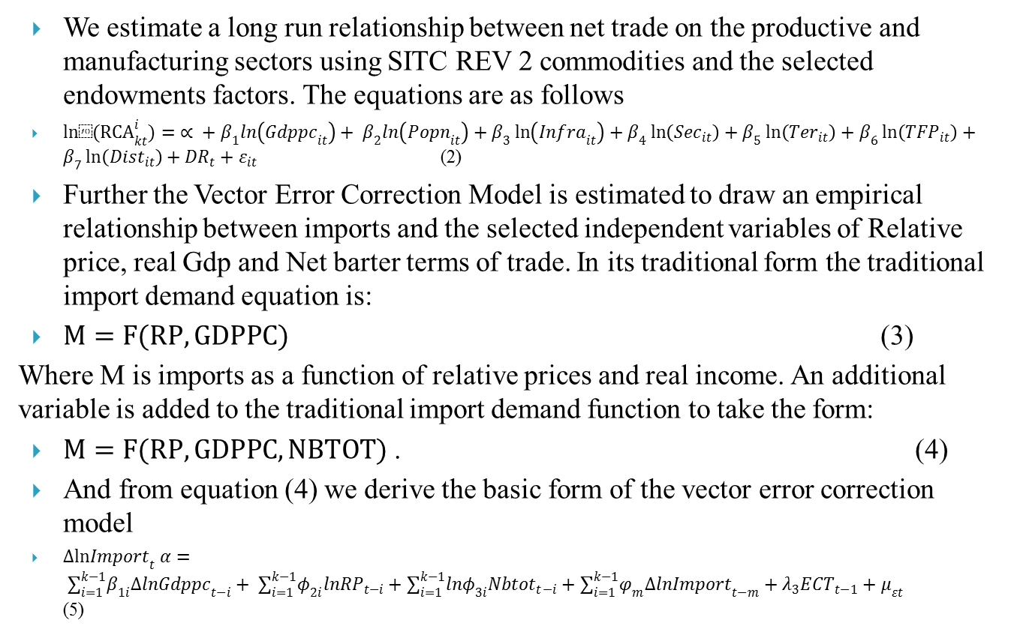
Estimated Equations
We estimate a long run relationship between net trade on the productive and manufacturing sectors using SITC REV 2 commodities and the selected endowments factors. The equations are as follows
${ln⁡(RCA}_{kt}^{i})= ∝ + β_{1}ln\left({Gdppc}_{it}\right)+ β_{2}ln\left({Popn}_{it}\right)+β_{3}\ln\left({Infra}_{it}\right)+β_{4}\ln\left({Sec}_{it}\right)+β_{5}\ln\left({Ter}_{it}\right)+β_{6}\ln\left({TFP}_{it}\right)+β_{7}\ln\left({Dist}_{it}\right)+{DR}_{t}+ε_{it}$ (2)
Further the Vector Error Correction Model is estimated to draw an empirical relationship between imports and the selected independent variables of Relative price, real Gdp and Net barter terms of trade. In its traditional form the traditional import demand equation is:
$M=F(RP, GDPPC)$ (3)
Where M is imports as a function of relative prices and real income. An additional variable is added to the traditional import demand function to take the form:
$M=F(RP, GDPPC, NBTOT)$ . (4)
And from equation (4) we derive the basic form of the vector error correction model
$∆ln{Import}_{t} α= ∑_{i=1}^{k−1}β_{1i}∆ln{Gdppc}_{t−i}+ ∑_{i=1}^{k−1}φ_{2i}ln{RP}_{t−i}+∑_{i=1}^{k−1}lnφ_{3i}{Nbtot}_{t−i}+∑_{i=1}^{k−1}φ_{m}Δln{Import}_{t−m}+λ_{3}{ECT}_{t−1}+μ_{εt}$ (5)

Slide 15
Table 2.0:Impact of import demand of productive manufacturing sectors on national endowment sectors
VARIABLES | TEC (1) | CIE (2) | USE (3) | SKE (4) | NRE (5) | PFE (6) | MNE (7)
GDPPC | 0.000013*** (2.61e-06) | 0.00073 (0.00065) | 0.000075** (0.000029) | 0.000031*** (7.36e-06) | 0.00028 (0.00026) | 0.000029*** (4.77e-06) | 0.00016 (0.0001)
POPN | 0.2615*** (0.0285) | 0.5576*** (0.0902) | 0.1161*** (0.0185) | 0.3518*** (0.0714) | 0.5964*** (0.0795) | 0.4455*** (0.0561) | 0.4375*** (0.0682)
INFRA | 0.4160*** (0.0322) | -0.0026 (0.0971) | 0.4013*** (0.0412) | 0.4872*** (0.0992) | 0.4794*** (0.0594) | 0.5199*** (0.0609) | 0.2596*** (0.0693)
SEC | 1.9058*** (0.0688) | 2.28*** (0.1565) | 0.7066*** (0.0656) | 0.4360** (0.2014) | 1.72*** (0.1261) | 0.6661*** (0.1375) | 1.199*** (0.1275)
TER | 0.3248*** (0.0438) | -0.2528** (0.0875) | 0.1074** (0.0523) | 0.9102*** (0.1406) | 0.2388** (0.0815) | 0.0910 (0.0852) | 0.0761 (0.0872)
TFP | -0.0700 (0.0581) | 0.4510** (0.1325) | -0.2906*** (0.0432) | 0.1701 (0.1306) | 0.3554*** (0.0984) | 0.3445*** (0.0735) | -0.0092 (0.1065)
DIST | -0.1349** 0.0629 | -0.1671 (0.2696) | -0.1057** (0.0465) | -0.0828 (0.2241) | -0.1647 (0.1064) | -0.1340** (0.0487) | 0.1972 (0.1589)
RD DUMMY | YES | YES | YES | YES | YES | YES | YES
CONSTANT | -22.45*** (0.4319) | -27.39*** (1.2975) | -16.43*** (0.3536) | -20.34*** (1.2879) | -25.80*** (0.7309) | -23.61*** (0.6115) | -22.65 (0.9684)
OBSERVATIONS | 56,001 | 30,262 | 35,875 | 6,439 | 14,835 | 22,735 | 13,327
R-SQUARED | 0.21 | 0.21 | 0.10 | 0.22 | 0.18 | 0.12 | 0.13

Slide 16
Tables 4.0: Estimates for VECM for selected countries
variables | Short run Elasticities | Long run Elasticities
Import | -0.0677*** | -0.6865***
Gddpc | 0.1679*** | 0.2320***
Rp | -0.4129** | -1.2778***
ntot | -1.1872** | -2.2963***
constant | 2.6293
ect | -0.6865
R squared | 0.52
Source: Author’s estimation

Slide 17
Conclusion and recommendation
Comparing the above models of estimation, it is obvious that we fail to reject hypothesis: H_{o} and H₁. Real Gdp has a positive relationship with the importation of the aforementioned productive and manufacturing sectors. The implication is that consumers prefer the consumption of imported sophisticated commodities in the absence of domestic substitute. A negative coefficient of relative price implies that demand for the importation of commodities is inelastic. In addition, the negative coefficient of net barter terms of trade implies expensive imports in the productive and manufacturing sectors of trade for importers
The level and quality of a countries infrastructure especially in communication contributes to growth of trade. This affirms the positive relationship between infrastructure and the importation in these sectors. We therefore fail to reject H₂.
Importation in the productive and manufacturing sectors have a positive impact on secondary sectors of national endowment, hence we reject H₃.
We reject H₄: this is because manufactured imports in technology sectors, unskilled sectors, skilled sectors, natural resource sectors has a positive impact on tertiary sectors of national endowments. However, importations in capital intensive sectors have a negative impact on tertiary sectors of national endowment, whiles importations in mineral resource sectors even though with a positive coefficient was insignificant.

Slide 18
This finding is empirically vexing and hence the question why importations in the productive and manufacturing sectors have a positive impact on secondary and tertiary endowment sectors of African countries? We hope future researchers can offer better insights into this.
Results on H₅: is also not clear. This is because importations in capital intensive sectors, natural resource sectors and processed food sectors had a positive impact on total factor productivity, on the contrary, importations in technology sectors, unskilled sectors, mineral resource sectors has a negative impact on the level of total factor productivity. The implication is that the level of total factor productivity among African countries as measured is positively and negatively affected. This perplexing finding explains the low level of total factor productivity among African countries.
With an inelastic demand for imports, a rising real Gdp and a growing market size it is important for African countries to pursue an aggressive industrial policy to solve the problem of inconsistent and declining total factor productivity.

Slide 19
References
African Trade Report 2018.
Anderson, James E., And Eric Van Wincoop, 2004. “Trade Cost,” Journal Of Economic Literature,Volume 42, September,691-751.
Barro, R. & Sala-I-Martin, X. (1995). Economic Growth. New York: Mcgraw-Hill.
Anderson, James E., And Eric Van Wincoop, 2004. “Trade Cost,” Journal Of Economic Literature,Volume 42, September,691-751.
The Great shift: Macroeconomic projections for the world economy at the 2050 horizon. CEPII working paper, 2012

